Slide 1
Networking and Cloud Services
A Developer's Guide to Windows 10 Andy & Jerry

Slide 2
Azure App Services mobile apps
REST services
Authentication
Credential locker
Web Account Manager

Slide 3



Mobility and the cloud is the new normal
66%
25%
33%
of employees use personal devices for work purposes.*
of all software will be available on a SaaS delivery by 2020.**
of employees that typically work on employer premises, also frequently work away from their desks.***
*CEB The Future of Corporate ITL: 203-2017. 2013.
**Forrester Application Adoption Trends: The Rise Of SaaS
***CEB IT Impact Report: Five Key Findings on Driving Employee Productivity Q1 2014.

Slide 4
Basics

Slide 5
Considerations
Mobile devices (tablets, etc.) are not always connected
Caching is important
Different networks can have different cost models associated
More expensive to use cellular data than WiFi in most cases
Startup experience, especially disconnected startup, is very important
No one likes an app that has to wait for a download or a timeout before it becomes responsive
Notes:
With network connected apps we have new challenges to provide responsive apps.
For example, it’s not realistic to assume unlimited bandwidth, or even a stable connection. Apps need to be responsive and resilient when the network isn’t available or reliable.
Apps which show live data shouldn’t make the user wait for a service call before showing the UI. You need to be intelligent about how you cache data and how the app starts up and enables interaction.

Slide 6
Capabilities
On Windows UWP:
internetClient
Required for outbound traffic to Internet
internetClientServer
Typically for peer-to-peer communication
privateNetworkClientServer
For access to resources on a private network at home or work
<?xml version="1.0" encoding="utf-8"?>
<Package … >
…
<Capabilities>
<Capability Name="internetClient" />
</Capabilities>
</Package>
Notes:
We’ve seen the app manifest and capabilities tab several times so far.
Many of the capabilities in the app manifest are related to network access.
The internetClient capability provides outbound access to the Internet and public networks through the firewall. Almost all web apps use this capability. The internetClientServer capability provides inbound and outbound access to the Internet and public networks through the firewall.
The internetClientServer capability is typically used in peer-to-peer (P2P) scenarios in apps that use file share and VOIP. The internetClientServer capability includes the access that the internetClient capability provides, so you don't need to specify internetClient when you specify internetClientServer.
An important certification requirement is to include a link to your Privacy Policy on the Setting pane if you declare these capabilities. Forgetting to do so is one of the most common certification blockers.
Home and work networks
The privateNetworkClientServer capability provides inbound and outbound access to home and work networks through the firewall. This capability is typically used for games that communicate across the local area network (LAN), and for apps that share data across a variety of local devices. If your app specifies musicLibrary, picturesLibrary, or videosLibrary, you don't need to use this capability to access the corresponding library in a Home Group.
If the network you’re connecting to has sharing turned on in Windows, it’s a private network.

Slide 7
Use higher-level abstractions
Better to use high-level frameworks and services where available
Use Microsoft Azure App Services to build a cloud backend services, but use WebRoles, WorkerRoles, Queues etc if you need more flexibility
Use Microsoft Azure Notification Hubs to send notifications from backend services in preference to writing low-level networking code to achieve this
Use BackgroundTransfer to download/upload files
Use Web Account Manager to perform OAuth2 authentication against Internet identity providers
Use HttpClient for low level HTTP networking

Slide 8
Introduction to Microsoft Azure Mobile Apps

Slide 9
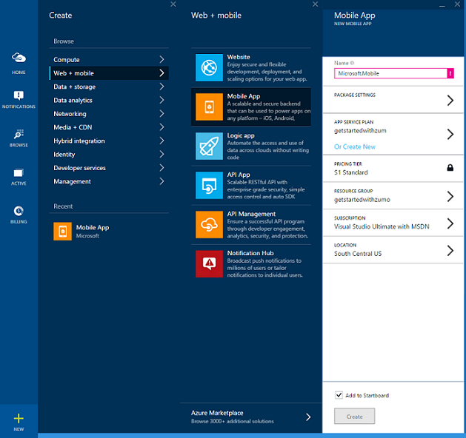
Microsoft Azure Mobile Apps
Build and Host the Backend for Any Mobile App
iOS, Android, Windows, HTML5, Xamarin
Code Backend in C# or NodeJS
Broadcast Push w/ Customer Segmentation
Enterprise Single Sign-On w/ Active Directory
Social Integration w/ Facebook, Twitter, Google
Integrate with SQL, Oracle, SAP, MongoDB
Auto-Scale to Millions of Devices
Enterprise Grade SLA

Slide 10
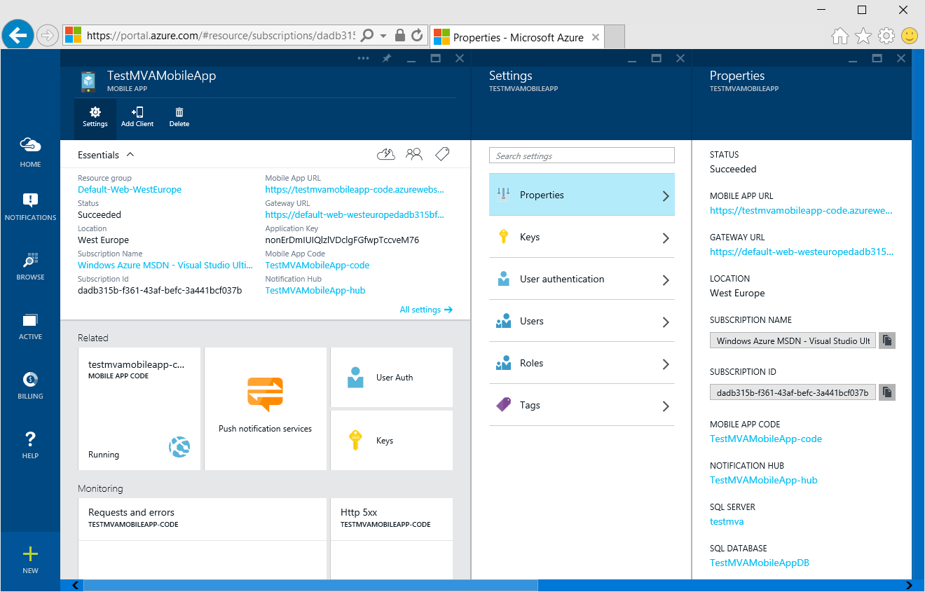
Create Your Mobile App in Azure Portal

Slide 11
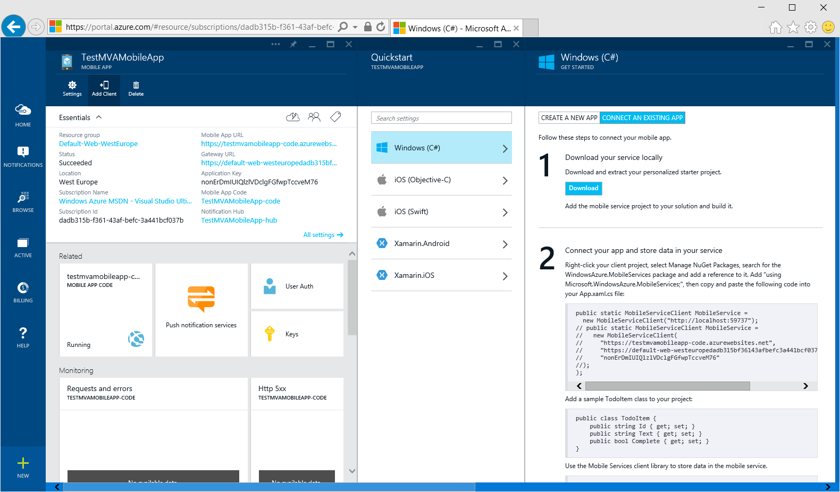
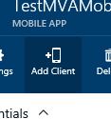
Configure Client App

Slide 12
Write code to work with your Mobile Service
private async System.Threading.Tasks.Task InsertToDoItem() { IMobileServiceTable<TodoItem> TodoTable = App.TaskMasterDemoClient.GetTable<TodoItem>(); TodoItem t = new TodoItem(); t.Title = titleTextBox.Text; t.Description = descriptionTextBox.Text; t.DueDate = dueDatePicker.Date.ToString(); t.AssignedTo = assignedToTextBox.Text; try { await TodoTable.InsertAsync(t); } catch (Exception) { /* TODO: Insert error handling code */ } }
Notes:
Good to mention that the record like ToDoItem, if it's modified on the server during the insert, gets the changes reflected in the client. Very handy!

Slide 13
Much, much more
Add Authentication against Microsoft Account, Twitter, Google, Facebook or Azure Active Directory
Partition data by user
Customize Mobile Services server logic
Implement business logic
Handle database write conflicts when two or more clients write to the same record
Call 3rd party services
Implement scheduled background tasks
Offline sync support
Clients can now work disconnected and sync changes to the online database when reconnected

Slide 14
Demo Windows Azure Mobile Apps

Slide 15
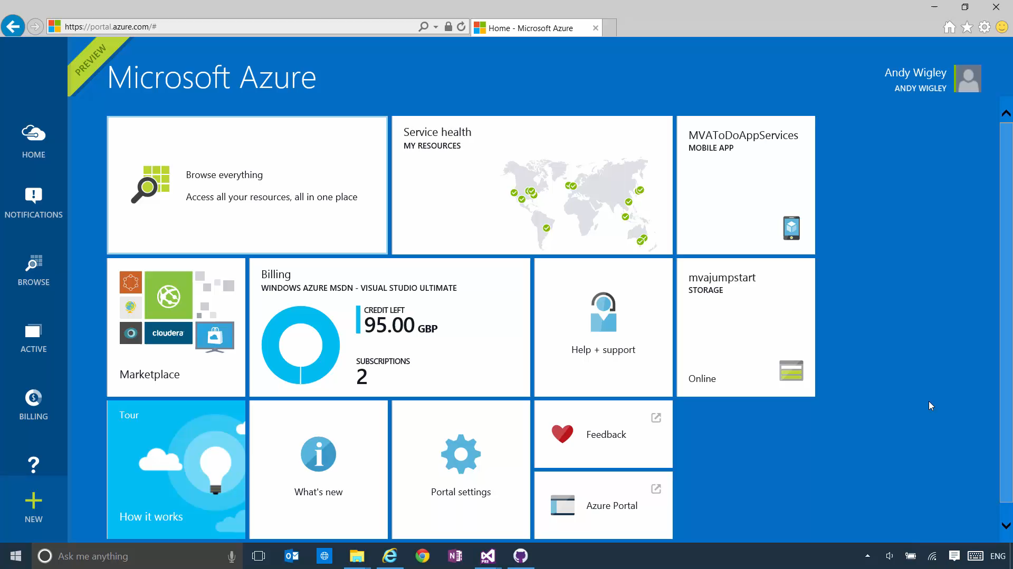

Slide 16
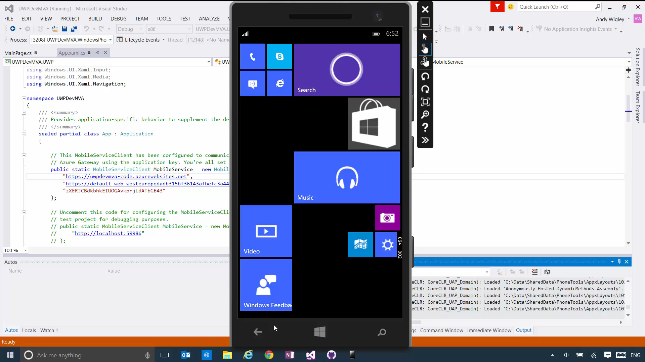

Slide 17
Accessing REST services with HttpClient

Slide 18
Simple example: Get a string
try { // Create the HttpClient HttpClient httpClient = new HttpClient();
// Optionally, define HTTP headers httpClient.DefaultRequestHeaders.Accept.TryParseAdd("application/json"); // Make the call string responseText = await httpClient.GetStringAsync( new Uri("http://services.odata.org/Northwind/Northwind.svc/Suppliers")); } catch (Exception ex) { ... }
Notes:
We’ve made it incredibly easy to get text back from a service
Getting strings back from a site or service should not be complicated. HttpClient was designed to provide flexibility, but also to keep the common scenarios as simple as possible.
Because this is a runtime component, it’s the same pattern in JavaScript and in C++

Slide 19
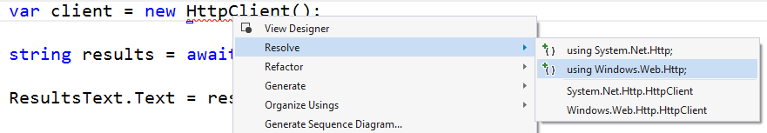
Tip
Resolve the correct type
System.Net.Http.HttpClient is slightly different in the most basic use, and quite different when you get into advanced work.
Always make sure you’re using Windows.Web.Http
System.Net.Http shows up first
Notes:
This might trip people up a bit, so good to point it out.

Slide 20
Get full response
HttpResponseMessage
Content
Headers
StatusCode
ReasonPhrase
IsSuccessStatusCode
Source
Version
RequestMessage
try { var client = new HttpClient(); var uri = new Uri(" http://example.com/customers/1"); var response = await client.GetAsync(uri); // code and results var statusCode = response.StatusCode; // EnsureSuccessStatusCode throws exception if not HTTP 200 response.EnsureSuccessStatusCode(); var responseText = await response.Content.ReadAsStringAsync(); } catch (Exception ex) { ... }
HttpClient
If you want response codes, headers, and other information, use GetAsync instead of GetStringAsync
Notes:
If you want more information than GetStringAsync provides, you can use GetAsync. This provides access to the full HttpResponseMessage
HttpResponseMessage
Content is the actual content returned
Headers gives you access to all the headers returned in the response
StatusCode and ReasonPhrase give you information on success or failure. Not sure which codes are considered successful? Use IsSuccessStatusCode to be sure.
Source tells you if the response was from the local cache of from the network
Version tells you the HTTP protocol version
Finally, RequestMessage provides you the original request which generated this response. You no longer need to track this separately and manually match up requests and responses in your code.

Slide 21
Reading response headers
try { var client = new HttpClient(); var uri = new Uri("http://example.com/customers/1"); var response = await client.GetAsync(uri); // display headers foreach (var header in response.Headers) { HeadersText.Text += header.Key + " = " + header.Value + "\n" ; } ResultsText.Text = await response.Content.ReadAsStringAsync(); } catch (Exception ex) { ...}
Notes:
The GetAsync method enables access to the full response, as we saw. Part of that is the set of response headers.
In this case, the response headers are only the response ones.
There’s a second set of headers, the response headers on the Content, which will see in a moment.

Slide 22
Writing request headers
Headers
var client = new HttpClient(); // set some headers var headers = client.DefaultRequestHeaders; headers.Referer = new Uri("http://contoso.com"); var ok = headers.UserAgent.TryParseAdd("testprogram/1.0"); // make the request var response = await client.GetAsync(uri); // get response content length var length = response.Content.Headers.ContentLength.Value; byte[] buffer = new byte[length];
Header | Access
Accept | read/write collection
AcceptEncoding | read/write collection
AcceptLanguage | read/write collection
Authorization | read/write
CacheControl | read/write collection
Connection | read/write collection
Cookie | read/write collection
Date | read/write
Expect | read/write collection
From | read/write
Host | read/write
IfModifiedSince | read/write
IfUnmodifiedSince | read/write
MaxForwards | read/write
ProxyAuthorization | read/write
Referer | read/write
TransferEncoding | read/write collection
UserAgent | read/write collection
Headers
Strongly typed headers make setting and getting values simple and safe.
Use the TryParseAdd method to receive a bool on failure rather than an exception
Notes:
Strongly typed headers help avoid errors. You don’t need to read the RFCs and understand the exact format required as you would if setting simple string values.
Instead, the platform handles the formatting and validation for you.
Examples: Host is a Hostname object
Referer is a Uri object
LastModifed and Date are great examples of this. Getting date formats correct is challenging for many developers. We take care of that for you.
Some headers, such as ContentLength are nullable types. Hence the .value.
If content length header is present on the wire and the response is compressed, we do not provide the content length to you as we won’t know that until after decompression, long after the headers are provided.
You can also add custom headers

Slide 23
Sending a request
HttpMethod
Delete
Get
Head
Options
Patch
Post
Put
Also, new HttpMethod(string) for your own methods
try
{
var client = new HttpClient();
// we're sending a delete request
var request = new HttpRequestMessage(HttpMethod.Delete, uri);
// we don't expect a response, but we'll snag it anyway
var response = await client.SendRequestAsync(request);
// display result code
HeadersText.Text = "Status: " + response.StatusCode + "\n";
}
catch (Exception ex)
{ … }
SendRequestAsync
The HttpClient includes discrete methods for Put and Post, but you can also use the SendRequestAsync method to make any type of request, including Delete.
Notes:
The most flexible of the methods is SendRequestAsync. This lets you do everything the GetAsync, PutAsync and PostAsync methods do, plus use additional http methods.
The HttpMethod you pass into the call supports all the usual suspects, as well as the ability for you to provide a string for custom or emerging methods.

Slide 24
HttpClient basics
demo
Notes:
Simple demo. Load up the HttpClient demo and run it to hit a site.
There are several examples, each of which you can use to walk through code.
The solution includes a web server with a WebAPI project with a service.
Suggest showing just GetStringAsync for a very simple call. We’ll cover the other demos later.

Slide 25
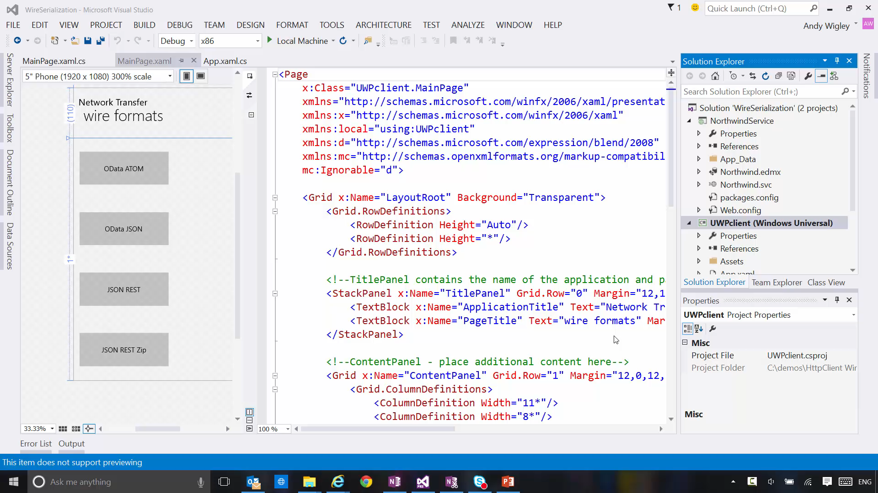

Slide 26
Setting cookies
var uri = new Uri("http://example.com/customers/1"); try { var baseFilter = new HttpBaseProtocolFilter(); var cookieManager = baseFilter.CookieManager; var cookie = new HttpCookie("favoriteColor", ".example.com", "/") { Value = "purple"}; cookieManager.SetCookie(cookie); var client = new HttpClient(baseFilter); await client.PostAsync(uri, new HttpStringContent("Pete")); } catch (Exception ex) { ... }
Notes:
You can easily set cookies using the CookieManager for the BaseProtocolFilter
This example also shows a simple use of the Post method, sending a single value to the server.
Once set, the cookie is sent with every subsequent request from the app.

Slide 27
Accessing cookies
var baseFilter = new HttpBaseProtocolFilter(); var cookieManager = baseFilter.CookieManager; var client = new HttpClient(baseFilter); var cookies = cookieManager.GetCookies(uri); // display cookies foreach (var cookie in cookies) { CookieList.Text += cookie.Name + " = " + cookie.Value + "\n"; }
Notes:
Note that you don’t even need to make a get request to get the cookies. Just call the cookie manager’s GetCookies method.
Cookies may be local or returned from the server

Slide 28
The filter pipeline
Your code
This is also a filter
Your app
HttpClient
GetAsync
GetBufferAsync
GetInputStreamAsync
GetStringAsync
PostAsync
PutAsync
SendRequestAsync
503 Retry Filter
Metered Network Filter
Auth Filter
Http Base Protocol Filter
Has in-depth settings
REST / Web Service
HttpRequestMessage
⛭
HttpResponseMessage
HttpContent
String • Stream • Buffer • Multipart • FormUrlEncoded
Notes:
The HTTP Processing pipeline can include your own filter code on the client, much like WebAPI can on the server (.NET handlers in that case).
This lets you encapsulate all the network-specific code outside of your app’s main logic by encapsulating it in filters.
Each filter sees every request message going out.
Each filter sees every response message coming back and can modify them to meet your requirements
We have sample filters in the MSDN Code Gallery: 503 Retry, Metered Network, OAuth2, for example
The 503 retry filter lets you continue to use the simple GetStringAsync without having to use the more complex approaches just to handle retries. This greatly simplifies your client logic. It doesn’t return the 503 to the client, but instead waits the specified amount of time and retries the call.
The Metered Network Filter handles restrictions due to metered (paid/cellular) networks.
The Auth filter handles all the steps necessary for OAuth2 without you cluttering your code with it. The token management, retries, etc. are all handled for you. You can find this in the WebAuthBroker sample http://code.msdn.microsoft.com/windowsapps/Web-Authentication-d0485122
We provide a number of example filters, but your own filters can be used for these things, auth, security, custom caches, logging, network restrictions, testing and much more.
Another great use is to add testing filters that mocks failures (404, junk data, captive proxy page, and more) to test your app.
Filters are very testable as they simply take a request/response and otherwise require no network connection.
Filters are WinRT components
Write in C++ or C# and then Use in any supported language
Implement Windows.Web.Http.Filters.IHttpFilter.
Just one method: SendRequestAsync ( + dispose)
Put them into the filter pipe line each time you create an HttpClient object
Most pipelines end with a HttpBaseProtocolFilter

Slide 29
Using HttpBaseProtocolFilter For compression, credentials etc
HttpBaseProtocolFilter filter = new HttpBaseProtocolFilter(); // When AutomaticDecompression is true (the default), the Accept-Encoding header is added // to the headers and set to allow gzip and compress filter.AutomaticDecompression = true; PasswordCredential creds = new PasswordCredential("JumpStart", userName, password); filter.ServerCredential = creds; filter.ProxyCredential = creds; // Create the HttpClient HttpClient httpClient = new HttpClient(filter); // Make the call string responseText = await httpClient.GetStringAsync(uri); ...

Slide 30
Identity and Authentication

Slide 31
Most apps need it…
Many applications need to be able to identify and authenticate users
Personalization, content
Integration with online service providers
The Paradox: Users dislike signing on…
The goal: Users Sign in once. And that’s it.

Slide 32
Credential Locker
APIs to securely store and roam user credentials
Windows.Security.Credentials
Benefits:
Secure storage
Credential isolation
Roaming
See: Connected Experiences module

Slide 33
Web Authentication
Easy authentication against MSA, AAD and online Service Providers e.g. Facebook, Twitter, etc.
Many apps connect to popular online service providers to provide a more personalized/social experience
Online service providers allow users to authorize other applications to interact with user data

Slide 34
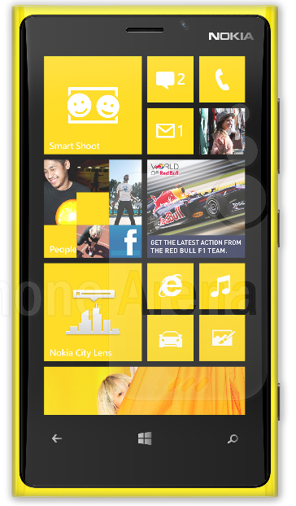





Typical OAuth flow
7. Data access
6. Authorization token (Redirect URL)
App
1. Authorization Request (Start URL)
Online
service
2. Login page
3. Credentials
4. Authorization page
5. User decision
User

Slide 35
Problems
Usually implemented with an embedded browser control
However…
No single sign-on
Credentials are entered into the application
Complicated to implement

Slide 36
The Solution
In 8.1, we had Web Authentication Broker (WAB), ADAL, OnlineID
But…
No native support for AAD auth in Windows
Competing development models
Existing solutions offered limited functionality
Poor end-user experience
In Windows 10, we have Web Account Manager
Handling of typical OAUTH scenarios right in the OS

Slide 37
Web Account Manager enables apps & identity providers to plug in to Windows 10 and provide SSO capabilities.
Notes:
Web Account Manager is an authentication infrastructure that enables apps & identity providers to plug in to Windows and provide SSO capabilities.
Talk about how this also has a third party story which I’ll get to later.

Slide 38
Web Account Manager APIs
RequestTokenAsync
Used to request a token
First attempts to retrieve the token silently
And if required, does so with UI.
GetTokenSilentlyAsync
Used to request a token from a background task/thread
Returns token by activating TB plugin without any UI.
Notes:
Talk about:
Win 32 support
Cache
Connected accounts
Account events
Multi-account apps
Accounts control (sample reference)

Slide 39
Output
WebTokenRequestResult
Results
WebTokenResponse i.e. Token and WebAccount
Status e.g. success, user cancelled, provider not available, provider specific errors, etc.
WebAccount
Object that represents a web account specific to an IDP
ID, WebAccountProvider, User Name, State, Properties, etc.
Can be used as a hint for subsequent token requests

Slide 40
Web Account Manager
Identity/Service Provider
App
Web Account Manager
Trust me…I can count. :)
Notes:
Remove System/User

Slide 41
Web Account Manager is extensible. Identity Providers can plug in to Windows via their Store app and provide SSO to apps & websites.
Notes:
Web Account Manager

Slide 42


Web Account Manager
Identity/Service Provider
App
Web Account Manager
Browser
Microsoft Web Account Provider
Web Account Provider
Contoso Web Account Provider
Web Account Provider
YOUR
Notes:
Remove System/User

Slide 43
Summary

Slide 44
Easily build cloud backend with Microsoft Azure App Services
Use Windows.Web.Http.HttpClient class for Http Networking
To seamlessly authenticate to MSA, AAD and/or online service providers, use Web Account Manager APIs

